Slide 1


Arun Deepak Tirkey
December 2, 2023

Slide 2

Outline
Executive Summary
Introduction
Methodology
Results
Conclusion
Appendix

Slide 3
Executive Summary
Summary of methodologies
SpaceX Data Collection using SpaceX API
SpaceX Data Collection with Web Scraping
SpaceX Data Wrangling
SpaceX Exploratory Data Analysis using SQL
Space-X EDA DataViz Using Python Pandas and Matplotlib
Space-X Launch Sites Analysis with Folium-Interactive Visual Analytics and Plotly Dash
SpaceX Machine Learning Landing Prediction
Summary of all results
EDA results
Interactive Visual Analytics and Dashboards
Predictive Analysis(Classification)

Slide 4
Introduction
Project background and context
SpaceX advertises Falcon 9 rocket launches on its website with a cost of 62 million dollars; other providers cost upward of 165 million dollars each, much of the savings is because SpaceX can reuse the first stage. Therefore if we can determine if the first stage will land, we can determine the cost of a launch. This information can be used if an alternate company wants to bid against SpaceX for a rocket launch.
Problems you want to find answers
In this capstone, we will predict if the Falcon 9 first stage will land successfully using data from Falcon 9 rocket launches advertised on its website.

Slide 5

Section 1

Slide 6
Methodology
Executive Summary
Data collection methodology:
How datasets were collected ?
Perform data wrangling
How data were processed ?
Perform exploratory data analysis (EDA) using visualization and SQL
Perform interactive visual analytics using Folium and Plotly Dash
Perform predictive analysis using classification models
How to build, tune, evaluate classification models ?

Slide 7
Data Collection
How data sets were collected?
Data were requested from SpaceX API.
Web scrapped Falcon9 and Falcon Heavy records from Wikipedia.

Slide 8
Data Collection – SpaceX API
Import requests, pandas and numpy libraries.
Request for data from SpaceX API using Get() request.
Normalised the json data into tables.
Output requested data with Head() function.
URL- Data Collection-SpaceX_API
Import libraries
get()
Json_normalize()
Head()

Slide 9
Data Collection - Scraping
Import requests, pandas, re and BeautifulSoup libraries.
Requesting response from wikipedia using Get() request.
Create a BeautifulSoup object from a response.
Find relevant entries of table using find_all() function.
Form dataframe with all entries.
URL- Data_Collection-WebScrapping
Import Libraries
Get()
BeautifulSoup()
soup.find_all()
To dataframe

Slide 10
Data Wrangling
How data were processed?
Check for missing values.
Correct datatype of variables.
Identify dependent variable .
Searching for valuable insights within variables statistically.
URL- Data_Wrangling
df.isnull().sum()
df.dtypes & atype()
df ['Outcome']
df[variable].value_counts()

Slide 11
EDA with Data Visualization
What charts were plotted and why you used those chart?
Scatter plot – Scatter plot can have three dimensions(variables) which help to visualize relationship of two variables based on dependent variable. Thus, Flight Number, Launch Site, payload mass and orbit columns were used to get relationship between themselves based on 'Class' variable.
Bar chart - Bar chart used to check average success rate of each orbit.
Line chart - Line chart is the best to show trends that’s why success outcome was shown over period of years.
URL- Data_Viz

Slide 12
EDA with SQL
The following SQL queries were performed :-
Display the names of the unique launch sites in the space mission.
Display 5 records where launch sites begin with the string 'CCA'.
Display the total payload mass carried by boosters launched by NASA (CRS).
List the names of the boosters which have success in drone ship and have payload mass greater than 4000 but less than 6000.

Slide 13
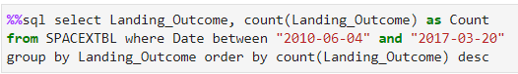
EDA with SQL (continued...)
The following SQL queries were performed :-
List the names of the booster_versions which have carried the maximum payload mass.
List the records which will display the month names, failure landing_outcomes in drone ship ,booster versions, launch_site for the months in year 2015.
Rank the count of landing outcomes between the date 2010-06-04 and 2017-03-20, in descending order.
URL - Data Viz with SQL

Slide 14
Build an Interactive Map with Folium
All the launch site were labeled on Folium map and map objects such as markers, circles were used to highlight all launch sites.
Lines between nearby mode of transport and city were drawn to get the distance.
These markers were drawn to know success rate of each sites.
URL - Folium Map

Slide 15
Build a Dashboard with Plotly Dash
Dashboard application contains:
Launch Site Drop-down Input Component
A callback function to render success-pie-chart based on selected site dropdown
Range Slider to Select Payload
A callback function to render the success-payload-scatter-chart scatter plot
These interactions were made to see proportion of success rate of launch sites and relationship between payload and booster version.
URL- Dash Dashboard

Slide 16
Predictive Analysis (Classification)
how the best classification model was build?
Convert dependent variable(Class) into Numpy array.
Standardize data with StandardScaler().
Split data in ratio 8:2.
Train model with hyperparameters in GridSearchCV().
Get R-square score with in-build score parameter.
URL- ML
Numpy array
Train and test split
Hyperparameters
Standarization
Score

Slide 17
Results
Exploratory data analysis results
Interactive analytics demo in screenshots
Predictive analysis results

Slide 18

Section 2

Slide 19
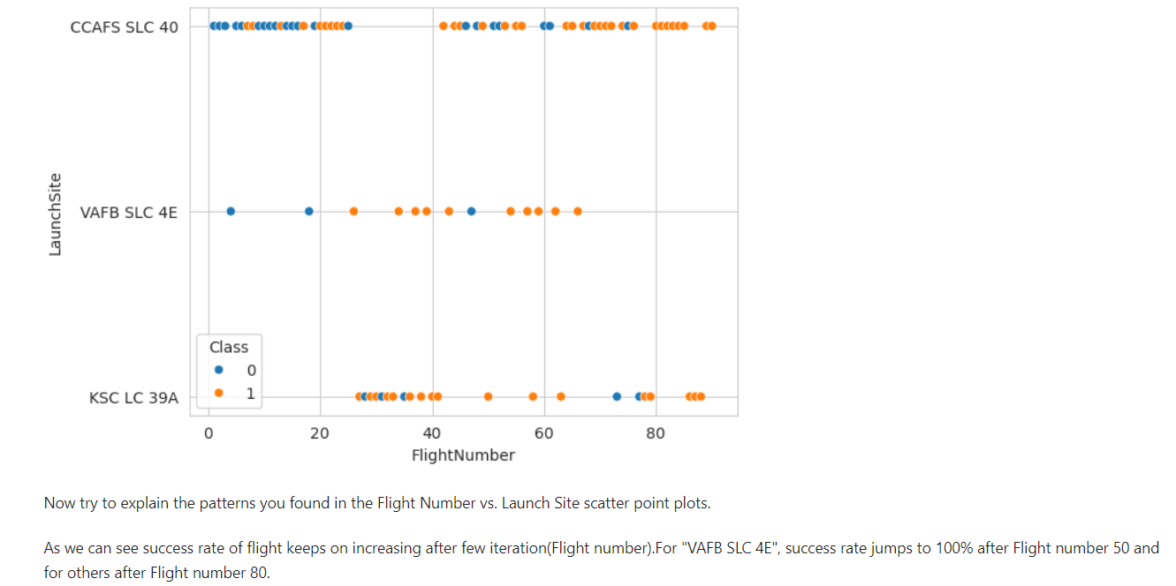
Flight Number vs. Launch Site

Slide 20
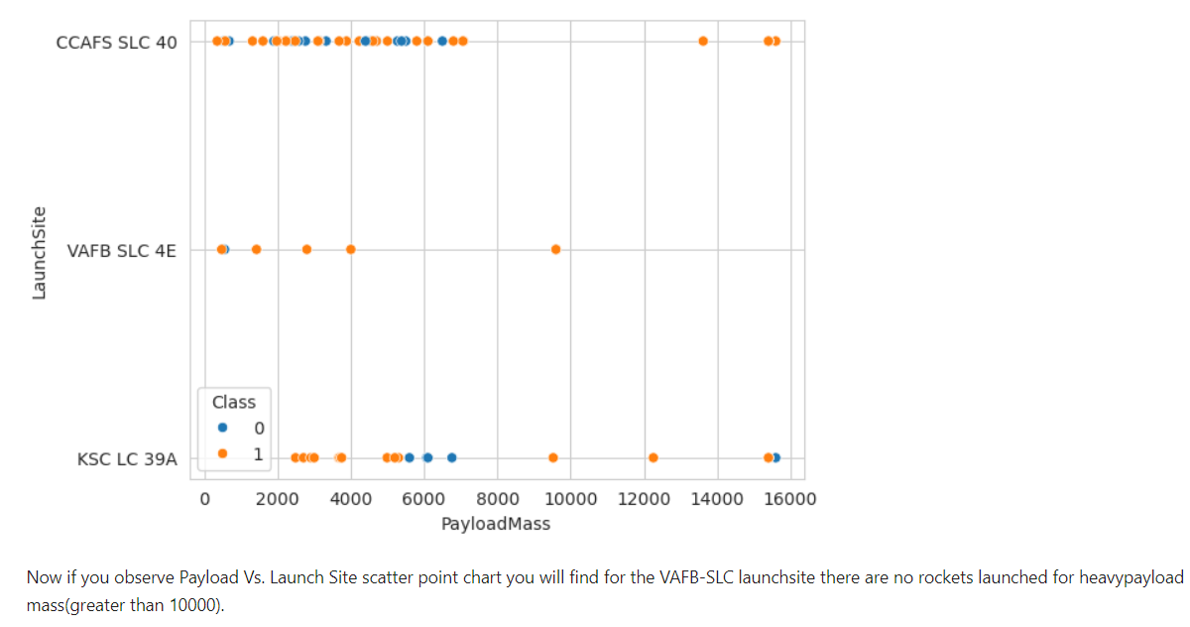
Payload vs. Launch Site

Slide 21
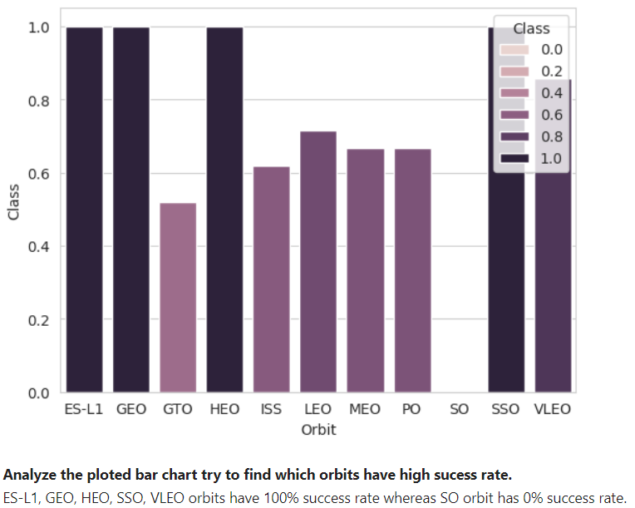
Success Rate vs. Orbit Type

Slide 22
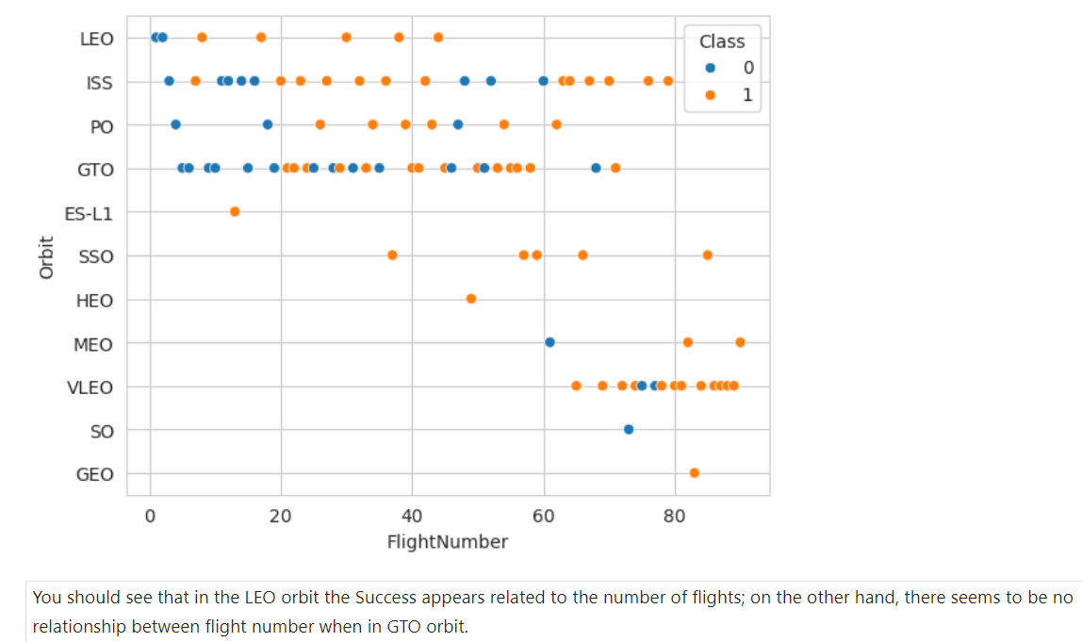
Flight Number vs. Orbit Type

Slide 23
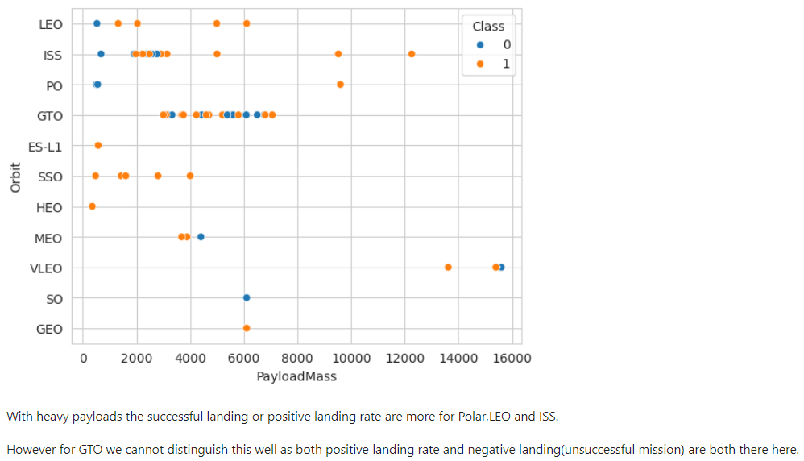
Payload vs. Orbit Type

Slide 24
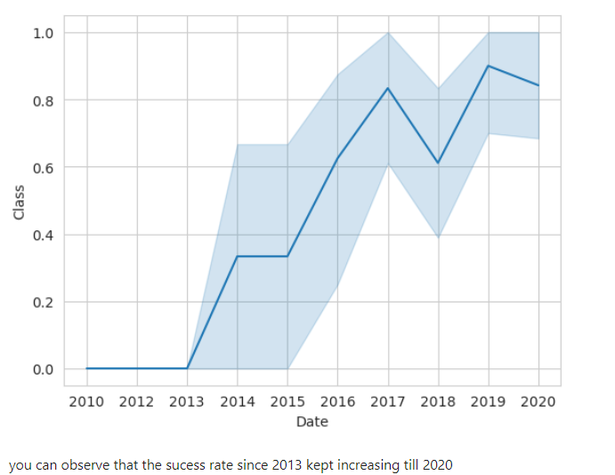
Launch Success Yearly Trend

Slide 25
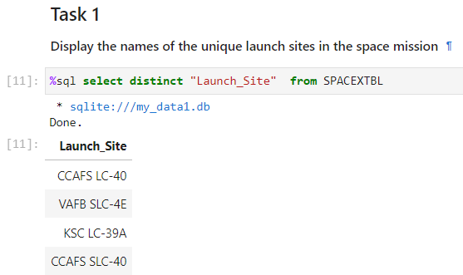
All Launch Site Names
Distinct keyword is used to select only unique values from output

Slide 26
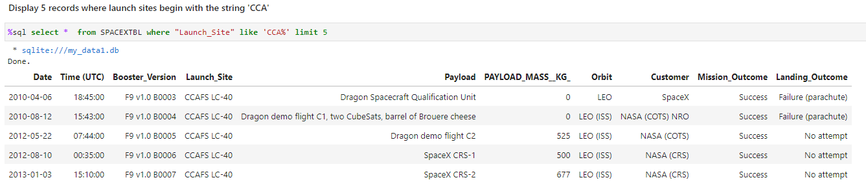
Launch Site Names Begin with 'CCA'
"LIKE" keyword used for finding regular expression and "CCA%" means finding all matching words starting with CCA.

Slide 27
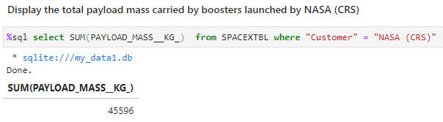
Total Payload Mass
SUM() function sum-up all the values in "Payload_mass_kg" column.

Slide 28
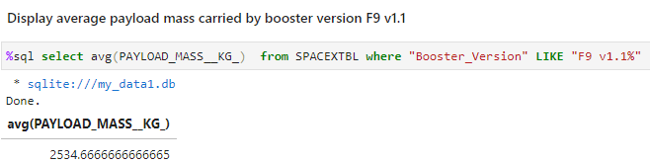
Average Payload Mass by F9 v1.1
AVG() function gives mean of values in "PAYLOAD_MASS_KG" column

Slide 29
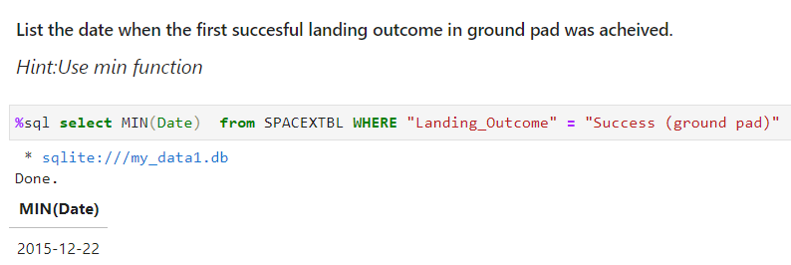
First Successful Ground Landing Date
MIN() function select minimum date within output

Slide 30
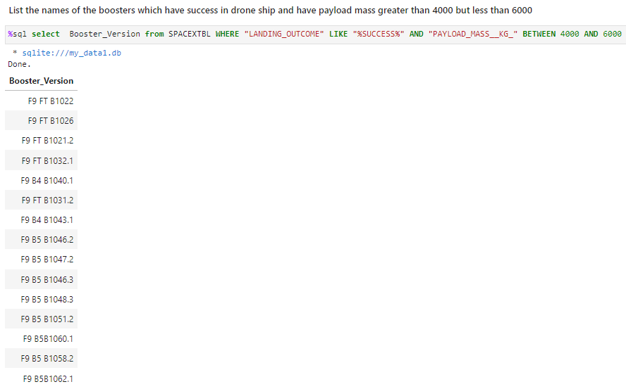
Successful Drone Ship Landing with Payload between 4000 and 6000
AND keyword used as logical operation which means true only if both side of operator are true.

Slide 31
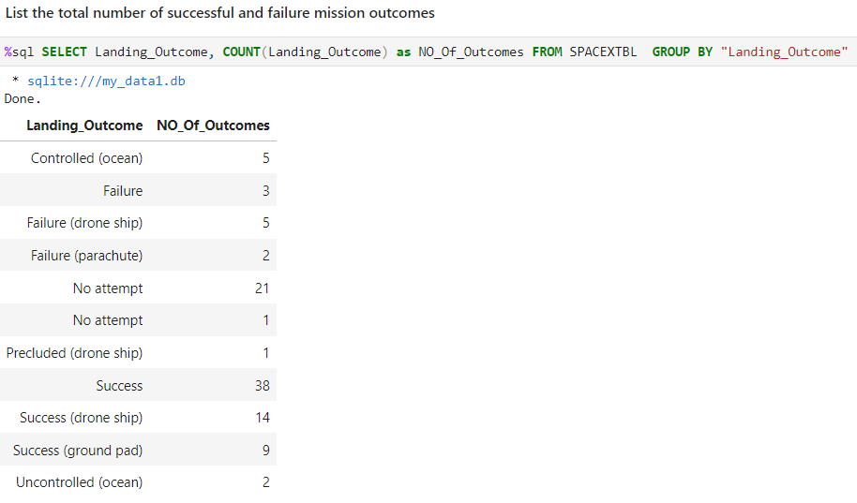
Total Number of Successful and Failure Mission Outcomes
"Group by" keyword group output according to selected column and "Count" keyword works jointly with groupby.

Slide 32
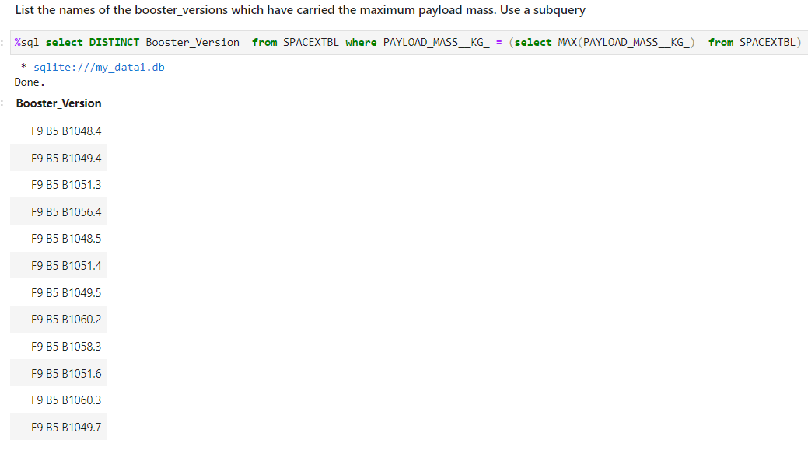
Boosters Carried Maximum Payload
First inner query run and output max payload then based on max payload outer query was filtered.

Slide 33
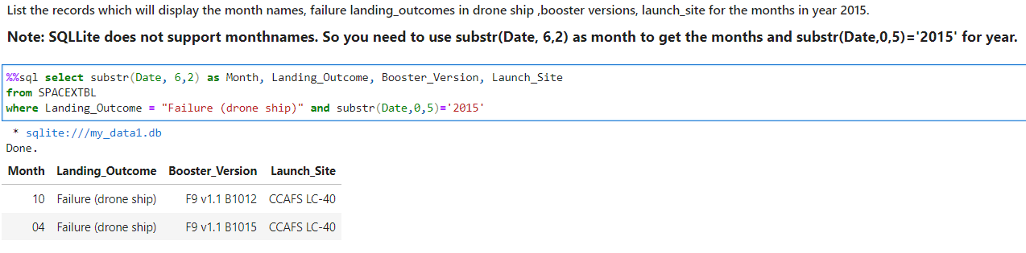
2015 Launch Records

Slide 34
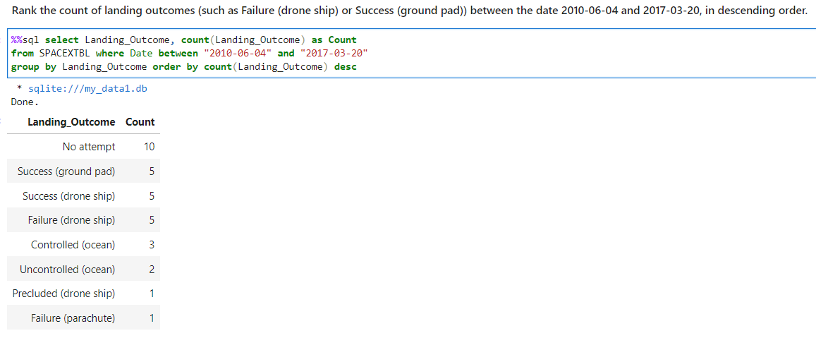
Rank Landing Outcomes Between 2010-06-04 and 2017-03-20

Slide 35

Section 3

Slide 36
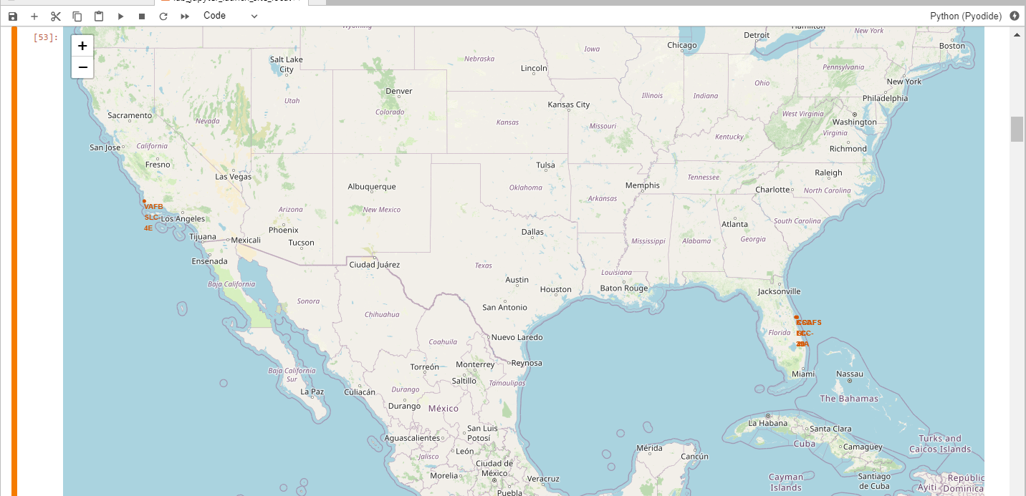
Markers of all launch sites on global map
All launch sites are in proximity to the Equator, (located southwards of the US map). Also all the launch sites are in very close proximity to the coast.

Slide 37
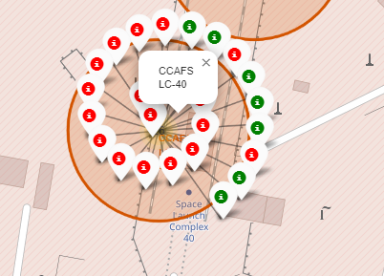
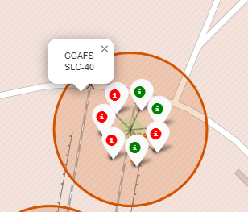
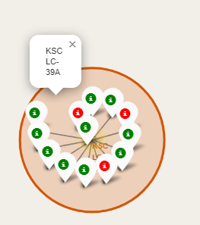
Launch outcomes for each site on the map with color markers
Florida Sites
•In the Eastern coast (Florida) Launch site KSC LC-39A has relatively high success rates compared to CCAFS SLC-40 & CCAFS LC-40.

Slide 38
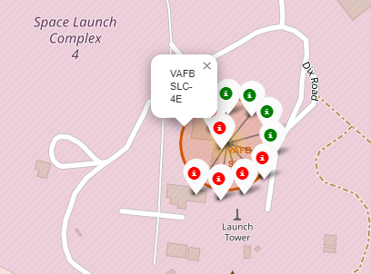
Launch outcomes for each site on the map with color markers
West Coast/ California
In the West Coast (California) Launch site VAFB SLC-4E has relatively lower success rates 4/10 compared to KSC LC-39A launch site in the Eastern Coast of Florida.

Slide 39
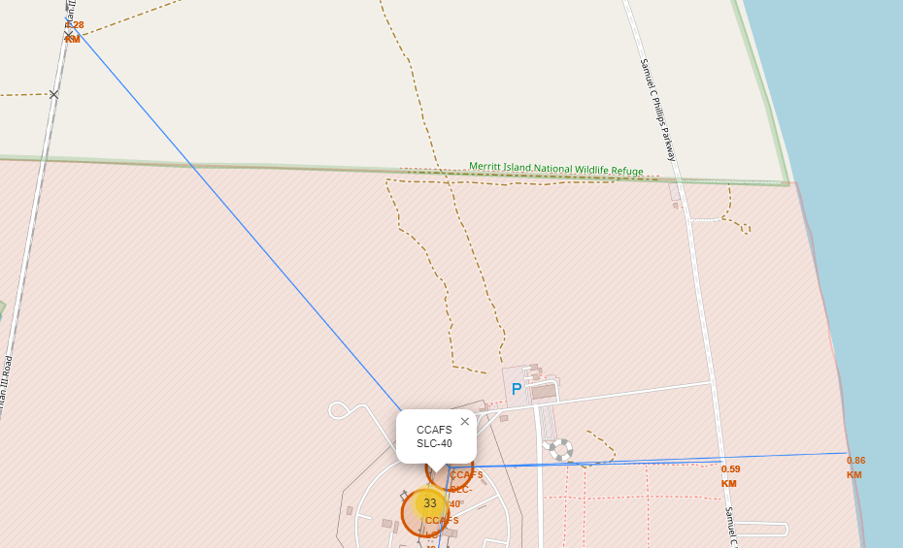
Distances between a launch site to its proximities
Launch site CCAFS SLC-40 proximity to coastline is 0.86 km

Slide 40
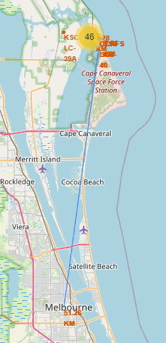
Distances between a launch site to its proximities
Launch site CCAFS SLC-40 closest to Melbourne City is 51.26 km

Slide 41

Section 4

Slide 42
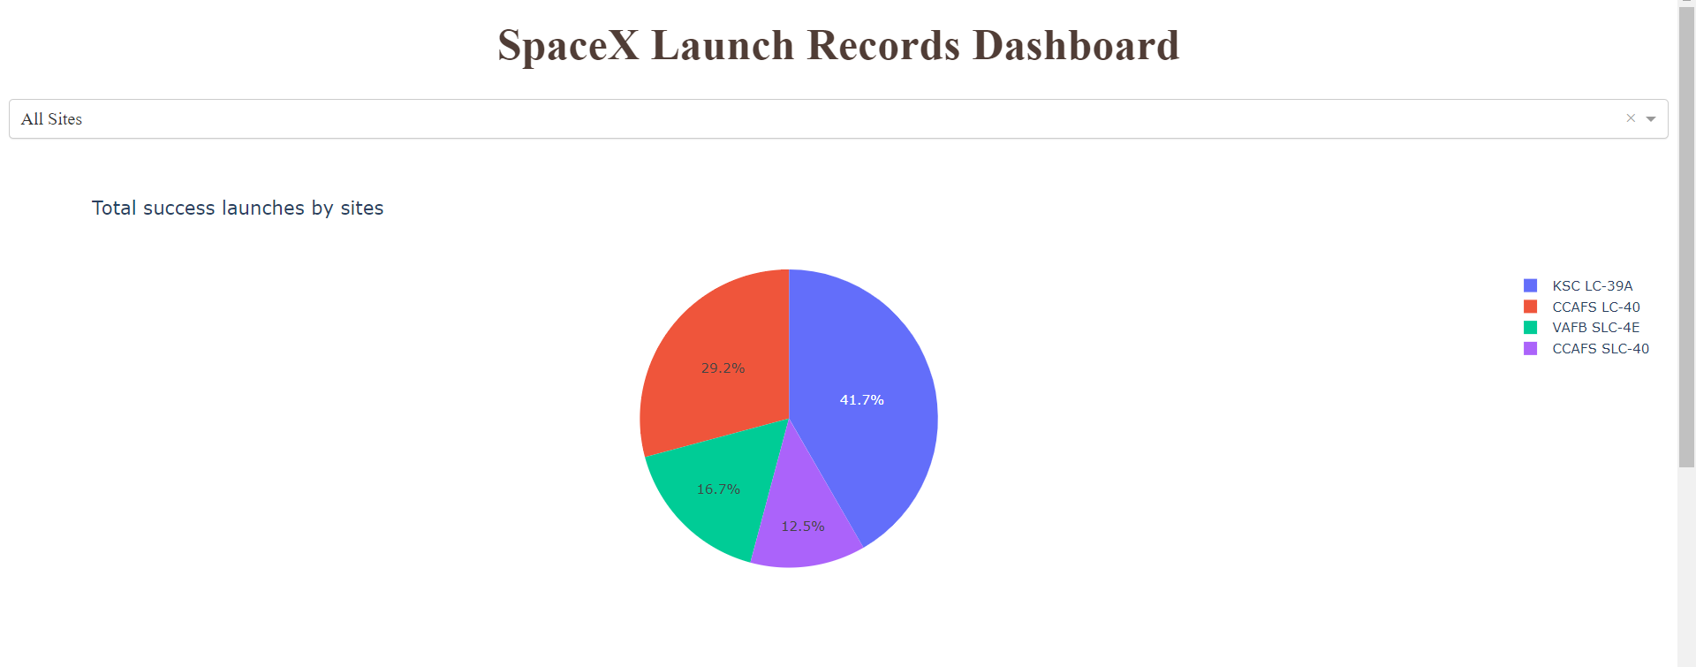
Pie-Chart for launch success count for all sites
Launch site KSC LC-39A has the highest launch success rate at 42% followed by CCAFS LC-40 at 29%, VAFB SLC-4E at 17% and lastly launch site CCAFS SLC-40 with a success rate of 13%.

Slide 43
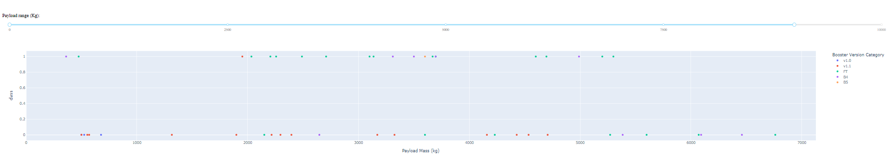
Payload vs. Launch Outcome scatter plot for all sites
As we can see success rate drop to zero after 5500Kg payload.

Slide 44
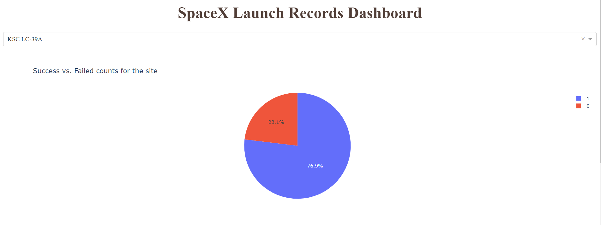
Pie-Chart for the launch site with highest launch site ratio.
Launch site KSC LC-39A had the highest success ratio of 77% success against 23% failed launches.

Slide 45
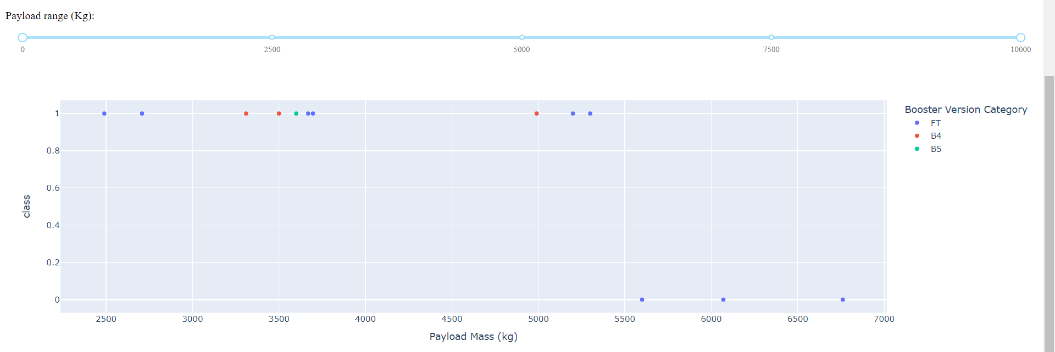
Scatter plot of the highest success rate launch site
Ratio of success rate is much higher than failure and all success rate falls below 5500Kg of payload.

Slide 46

Section 5

Slide 47
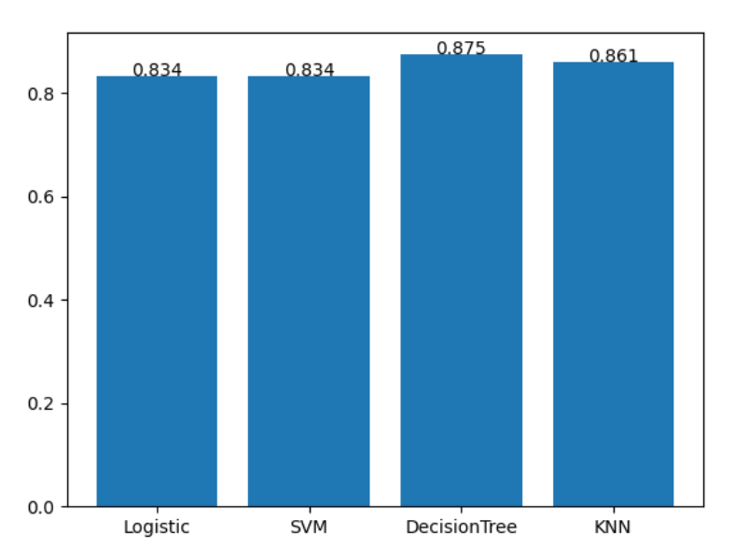
Classification Accuracy
All the models have almost same accuracy.
Decision tree has highest among them with 87%.

Slide 48
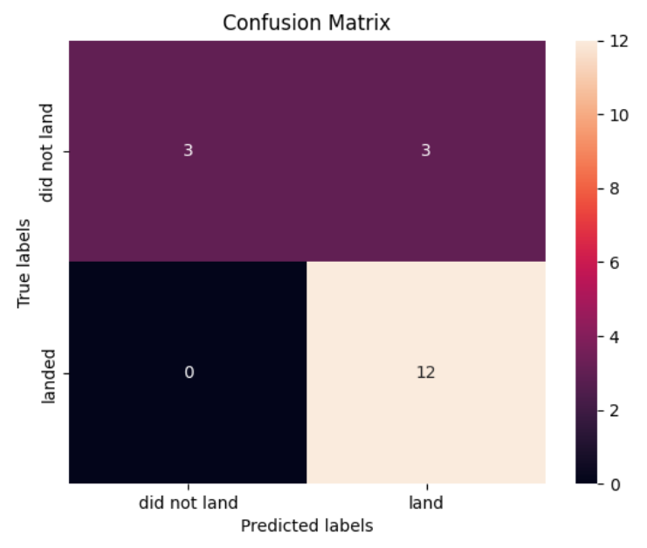
Confusion Matrix
All the models have same values for confusion matrix.
Value of false positive is less but could be reduced for more better landing of booster.

Slide 49
Conclusions
Different launch sites have different success rates. CCAFS LC-40, has a success rate of 60 %, while KSC LC-39A and VAFB SLC 4E has a success rate of 77%.
We can deduce that, as the flight number increases in each of the 3 launch sites, so does the success rate. For instance, the success rate for the VAFB SLC 4E launch site is 100% after the Flight number 50. Both KSC LC 39A and CCAFS SLC 40 have a 100% success rates after 80th flight
If you observe Payload Vs. Launch Site scatter point chart you will find for the VAFB-SLC launch site, there are no rockets launched for heavy payload mass(greater than 10000).
Orbits ES-L1, GEO, HEO & SSO have the highest success rates at 100%, with SO orbit having the lowest success rate at ~50%. Orbit SO has 0% success rate.
LEO orbit the Success appears related to the number of flights; on the other hand, there seems to be no relationship between flight number when in GTO orbit

Slide 50
Conclusions cont.
With heavy payloads the successful landing or positive landing rate are more for Polar, LEO and ISS. However for GTO we cannot distinguish this well as both positive landing rate and negative landing(unsuccessful mission) are both the same.
Finally the success rate since 2013 kept increasing till 2020.

Slide 51


